Slide 1
Slide 2
Module & Function
Dasar-Dasar Pemrograman 1
Semester Ganjil 2016/2017

Slide 2
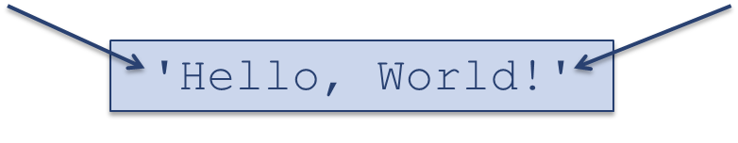
Strings
In addition to number and Boolean values, Python support string values
A string value is represented as a sequence of characters enclosed within quotes
A string value can be assigned to a variable
String values can be manipulated using string operators and functions
Dasar-Dasar Pemrograman Ganjil 2016-2017

Slide 3
String operators
Usage | Explanation
x in s | x is a substring of s
x not in s | x is not a substring of s
s + t | Concatenation of s and t
s * n, n * s | Concatenation of n copies of s
s[i] | Character at index i of s
len(s) | (function) Length of string s
Dasar-Dasar Pemrograman Ganjil 2016-2017

Slide 4
Modules
Python Modules are essentially files with Python statements
There are modules provided by Python to perform common tasks (math, database, web interaction, graphics, etc.)
The wealth of these modules is one of the great features pf Python
Dasar-Dasar Pemrograman Ganjil 2016-2017

Slide 5
Save as a “module”
When you save a file and place a .py suffix on it, it becomes a python module
You run the module from the IDLE menu to see the results of the operation
A module is just a file of python commands
Dasar-Dasar Pemrograman Ganjil 2016-2017

Slide 6
Syntax
Lexical components
A Python program is:
  A module (perhaps more than one)
  Each module has python statements
  Each statement has expressions
Dasar-Dasar Pemrograman Ganjil 2016-2017

Slide 7
Statements
Statements are commands in Python
They perform some action
For example: print(“Hello”)
Dasar-Dasar Pemrograman Ganjil 2016-2017

Slide 8
Getting input
The function:
  input (“Give me a value”)
    Prints “Give me value” on the python screen and waits till the user types something (anything), ending with Enter
    Warning: it returns a string (sequence of characters), no matter what is given, even a number
Is it “1” the same as 1?
Dasar-Dasar Pemrograman Ganjil 2016-2017

Slide 9
Printing output
var_a = 12
print (‘Value of var a is’, var_a)
print takes a list of elements in parentheses separated by commas
  If the element is a string, prits it as is
  If the element is a variable, prints the value associated with the variable
  After printing, moves on to a new line of output
Dasar-Dasar Pemrograman Ganjil 2016-2017

Slide 10
Output statements
A print statement can print any number of expressions
Successive print statements will display on separate lines
A bare print will print a blank line
Dasar-Dasar Pemrograman Ganjil 2016-2017

Slide 11
Expressions
Expressions
  The fragments of code that produce or calculate new data values are called expressions.
    Example: 3 + 4 * 5
  Literals and simple identifiers can also be expressions
Dasar-Dasar Pemrograman Ganjil 2016-2017

Slide 12
Literals
Literal is a programming notation for a fixed value
Examples:
  123 is a fixed value, an integer literal
  “Fasilkom” is a fixed value, a string literal
Dasar-Dasar Pemrograman Ganjil 2016-2017

Slide 13
Elements of Programs: Identifiers
Names
  Names are given to variables (e.g. celcius, fahrenheit), modules (main, convert), etc
  These names are called identifiers
  Every identifier must begin with a letter or underscore (“_”), followed by any sequence of letters, digits, or underscores
  Identifiers are case sensitive (upper and lower case letters are different)
  May be of any length
Dasar-Dasar Pemrograman Ganjil 2016-2017

Slide 14
Elements of Programs: Identifiers (1)
These are all different, valid identifiers
  fasilkom_ui_2016
  Celcius
  Spam
  Spam
  spAm
  Spam_and Eggs
  Spam_And_Eggs
Is the following identifier valid?
  123_ABC
Dasar-Dasar Pemrograman Ganjil 2016-2017

Slide 15
Reserved Words
Some identifiers are part of the Python language itself. Thee identifiers are known as reserved words. This means they are not available for you to use as a name for a variable, etc. in your program
Dasar-Dasar Pemrograman Ganjil 2016-2017

Slide 16
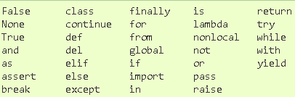
Complete list of reserved words in Python 3.x
Dasar-Dasar Pemrograman Ganjil 2016-2017

Slide 17
Whitespace
White space are characters that don’t print (e.g. blanks, tabs, carriage returns etc.)
For the most part, you can place white space (spaces) anywhere in your program
Use it to make a program more readable
Dasar-Dasar Pemrograman Ganjil 2016-2017

Slide 18
Continuation
However, python is sensitive to end of line stuff. To make a line continue, use the “\”
  print (“this is a test \
  of continuation”)
  Prints:
    This is a test of continuation
Dasar-Dasar Pemrograman Ganjil 2016-2017

Slide 19
Python comments
A comment begins with a # (pund sign / hash sign / number sign)
This means that from the # to the end of that line, nothing will be interpreted by Python
Dasar-Dasar Pemrograman Ganjil 2016-2017

Slide 20
Simultaneous Assignment
Several values can be calculated at the same time
<var>, <var>, … = <exp>, <exp>, ….
Evaluate the expressions in the RHS and assign them to the variables on the LHS
Dasar-Dasar Pemrograman Ganjil 2016-2017

Slide 21

Range and List
range is a built-in Python function that generates a sequence of numbers, starting with 0
list us a built-in Python function that turns the sequence into an explicit list
Dasar-Dasar Pemrograman Ganjil 2016-2017

Slide 22
Import of a module
We can import other modules with statement:
  import <module name>
For example: importing math module
  To import the math module, we can do with import math
  This brings in python statements to support math (try it in the python interpreter window)
  We precede all operations of math with math.xxx
Dasar-Dasar Pemrograman Ganjil 2016-2017

Slide 23
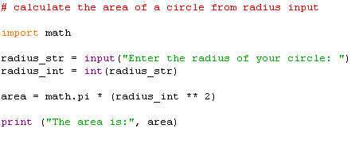
Import of a module: Example
Dasar-Dasar Pemrograman Ganjil 2016-2017

Slide 24
Python Function
A function is a block of organized, reusable code that is used to perform a single, related action
Functions provide better modularity for your application and a high degree of code reusing
As you already know, Python gives you many built-in functions like print(), etc. but you can also create your own functions. These functions are called user-defined functions
Dasar-Dasar Pemrograman Ganjil 2016-2017

Slide 25
Python function (1)
You can define functions to provide the required functionality. Here are simple rules to define a function in Python:
  Function blocks begin with the keyword def followed by the function name and parentheses
  Any input parameters or arguments should be placed within the parentheses
  The first statement of a function can be the documentation string of the function or docstring.
  The code block within every function starts with a colon (:) and is indented
  The statement return [expression] exits a function, optionally passing back an expression to the caller
Dasar-Dasar Pemrograman Ganjil 2016-2017

Slide 26

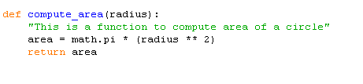
Syntax and example
Syntax
Example
Dasar-Dasar Pemrograman Ganjil 2016-2017

Slide 27
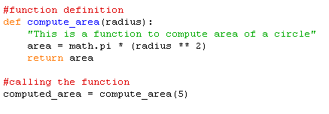
Calling a Function
Defining a function only gives it a name, specifies the parameters and structures the blocks of code
Once the basic structure of a function is finalized, you can execute it by calling the function
Example:
Dasar-Dasar Pemrograman Ganjil 2016-2017

Slide 28
References
William Punch & Richard Enbody. The Practice of Computing using Python, 2nd Edition. Addison-Wesley, 2013
Y. Daniel Liang. Introduction to Programming Using Python. Prentice Hall, 2013.
John Zelle. Python Programming: An Introduction to Computer Science, 2nd Edition. Franklin, Beedle & Associates Inc., 2010.
Mark Lutz. Learning Python, 5th Edition. O’Reilly Media. Copyright 2013 Mark Lutz, 978-1-44-93-5573-9
L. Y. Stefanus. Slide Pelatihan Python. 2015.
Dasar-Dasar Pemrograman Ganjil 2016-2017

